Slide 1
CP 111: Principles of programming
BRANCHING and LOOPS

Slide 2
Contents
Branching Statement
IF Statement
Switch Statement
Loops
Condition Tested Loops
Counted Loops
Endless Loops
FOR Loop
WHILE Loop
DO-WHILE Loop

Slide 3
Branching Statement
A program consists of a number of statements which are usually executed in sequence.
Programs can be much more powerful if we can control the order in which statements are run.
The Branching Statements or Control Statements let the program makes a decision about what to do next.

Slide 4
IF Statement
The IF Statement is a powerful decision making statement and is used to control the flow of execution of statements.
It is basically a two-way decision statement and is used in conjunction with an expression.

Slide 5
IF Statement
It allows the computer to evaluate the expression first and then, depending on whether the value of the expression (relation or condition) is ' true ' (non-zero) or ' false ' (zero), it transfers the control to a particular statement.
This point of program has two paths to follow, one for the true condition and the other for the false condition.
The if statement may be implemented in different forms depending on the complexity of the conditions to be tested.

Slide 6
IF Statement
IF Statement
Two types of IF Statement:
– Simple IF Statement
– IF-ELSE Statement

Slide 7
IF Statement
Simple IF Statement
The statement-block may be a single statement or a group of statements.
If the test expression is true, the statement-block will be executed; otherwise the statement-block will be skipped and the execution will jump to statement-x.
Remember, when the condition is true both the statement-block and the statement-x are executed in sequence.

Slide 8
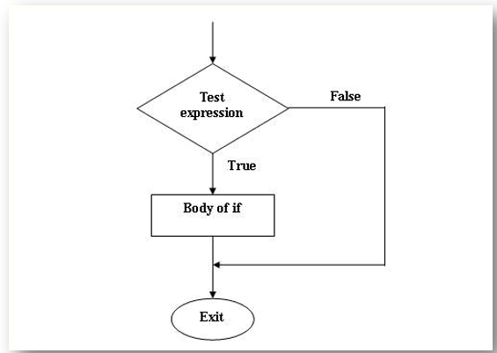
IF Statement
Simple IF Statement

Slide 9
IF Statement
IF-ELSE Statement
The if....else statement is an extension of the simple if statement.
If the test expression is true , then the true-block statement(s), immediately following the if statement are executed; otherwise the false-block statement(s) are executed.
In either case, either true-block or false-block will be executed, not both.

Slide 10
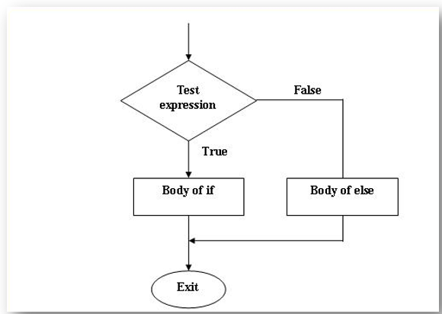
IF Statement
IF-ELSE Statement

Slide 11
IF Statement (example 1)
Draw the flow chart shows a program which ask a user to enter a number, and then compare the number given either it is bigger or smaller than 5.

Slide 12
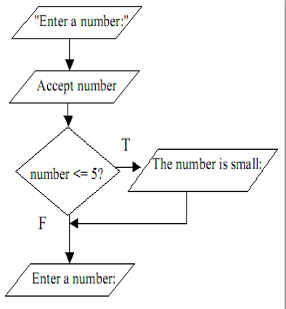
IF Statement (solution for example 1)

Slide 13
IF Statement (solution for example 2)
Draw the flow chart shows a program to check whether the student “Passed” or “Failed”.

Slide 14
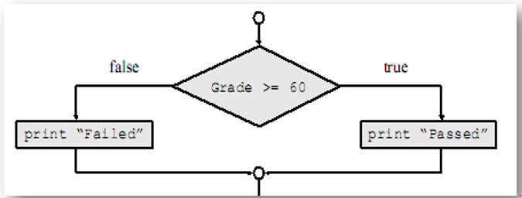
IF Statement (solution for example 2)

Slide 15
SWITCH Statement
In computer programming, a Switch Statement (also known as Case Statement) is a type of control statement that exists in most modern imperative programming languages.
This is another form of the multi way decision.
A switch statement is a selection statement that lets you transfer control to different statements within the switch body depending on the value of the switch expression.

Slide 16
SWITCH Statement
SWITCH Statement
If the value of the switch expression equals the value of one of the case expressions, the statements following that case expression are processed.
If not, the default label statements, if any, are processed.

Slide 17
SWITCH Statement
switch structure: alternate to if-else
switch (integral) expression is evaluated first
Value of the expression determines which corresponding action is taken
Expression is sometimes called the selector

Slide 18
SWITCH Statement (syntax)

Slide 19
Repetition (loops)
Everyday Life: Every second, we are engaged in one or more control structures.

Slide 20
Everyday Life: Every second, we are engaged in one or more control structures.
We listen WHILE the boss is talking.
I smile WHILE I am happy.
I sleep WHILE I am tired.
I rest WHILE I am sick.
I yell WHILE I am mad.

Slide 21
Why Is Repetition Needed?
Repetition allows you to efficiently use variables
Can input, add, and average multiple numbers using a limited number of variables
For example, to add five numbers:
  Declare a variable for each number, input the numbers and add the variables together
  Create a loop that reads a number into a variable and adds it to a variable that contains the sum of the numbers

Slide 22
Loop (repetition)
A loop is a sequence of instructions that is continually repeated until a certain condition is reached.
Loops allow for the same statement to be executed a number of times in succession.

Slide 23
Types of Loops
FOR Loop
WHILE Loop
DO … WHILE Loop

Slide 24
FOR Loop
A FOR loop is a loop that repeats a specified number of times.
The loop uses a counter to tell it how many times to run the same sequence of activities.
The counter has the following three numeric values:
– Initial counter value
– Condition
– Increment/Decrement (the amount to add to the counter each time the loop runs)

Slide 25
FOR Loop
The loop ends when the counter reaches the condition, or, if there is an associated test condition, when the test condition is true.

Slide 26
FOR Loop (syntax)
FOR (initial counter value, condition, increment/decrement)
Statement (Do Something)

Slide 27
FOR loop (Pseudocode)
FOR x times
Do Something
Increment/Decrement

Slide 28
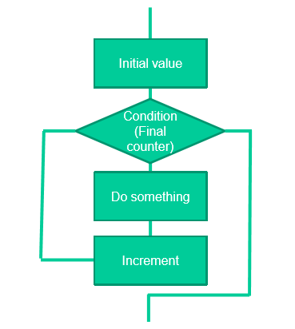
For loop (Flow chart)

Slide 29
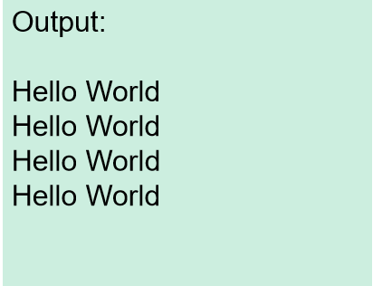
For loop (example 1)
for (x=1, x<5, x++)
PRINT “Hello World”

Slide 30
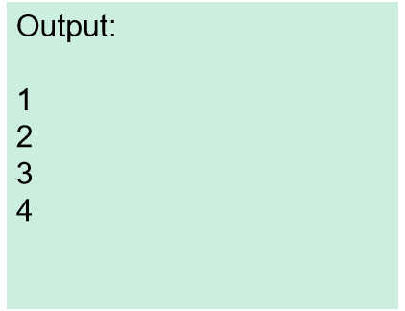
For loop (Example 2)
for (x=1, x<=4, x++)
PRINT x

Slide 31
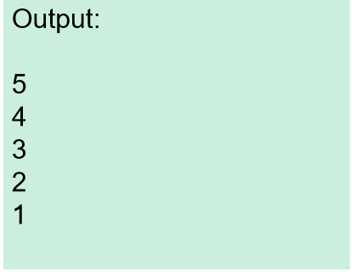
For loop (example 3)
for (x=5, x>0, x--)
PRINT x

Slide 32
While loop
A WHILE loop is a loop that repeats while some condition is satisfied.
The WHILE loop tests its condition at the beginning of every loop.
If the condition is false from the start, the sequence of activities contained in the loop never runs at all.

Slide 33
While loop syntax
WHILE (Condition)
Statement (Do Something)

Slide 34
While loop (pseudocode)
WHILE condition
Do Something

Slide 35
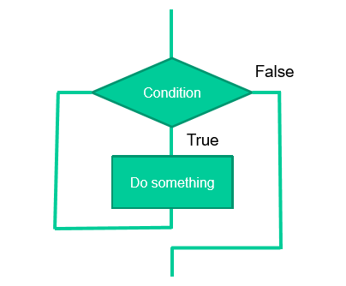
While loop (flow chart)

Slide 36
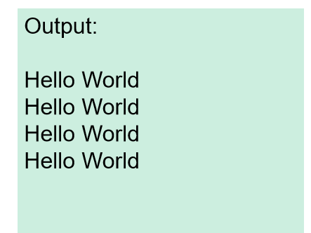
While loop (example 1)
WHILE (x < 5)
PRINT “Hello World”
x++

Slide 37
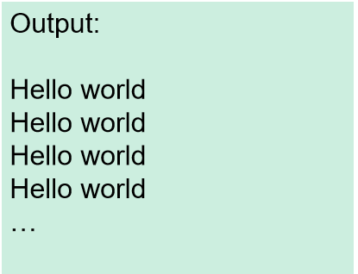
While loop (example 2)
WHILE (key != Esc)
PRINT “Hello World”

Slide 38
DO-WHILE Loop
Like a while loop, a do-while loop is a loop that repeats while some condition is satisfied.
Unlike a while loop, a do-while loop tests its condition at the end of the loop.
This means that its sequence of activities always runs at least once.

Slide 39
Do-while loop (syntax)
DO
Statement
WHILE (Condition)

Slide 40
Do-while loop (pseudocode)
Do
something
WHILE condition

Slide 41
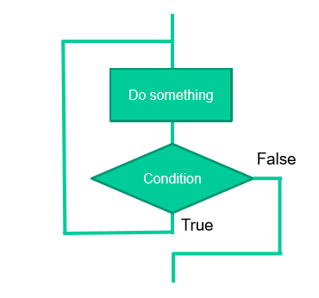
Do-while loop (flow chart)

Slide 42
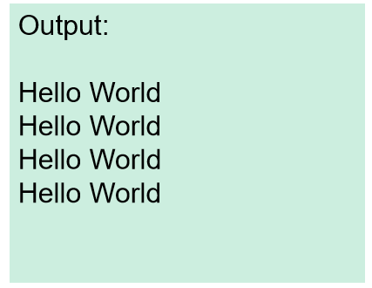
Do-while (example 1)
x=1
DO
PRINT “Hello World”
x++
WHILE (x<5)

Slide 43
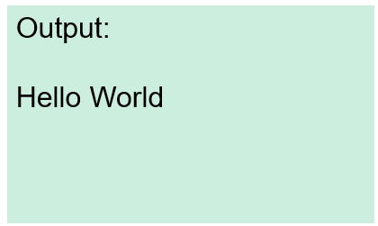
Do-while (example 2)
x=1
DO
PRINT “Hello World”
x++
WHILE (x>5)

Slide 44
Assignment
Draw flowchart diagram for the following programs using loop:
A program that display number 1 to 20
A program that display a person name 5 times.

Slide 45
end

